Slide 1
EmoDec
Emotion Detection
Submitted by
Harshit verma

Slide 2
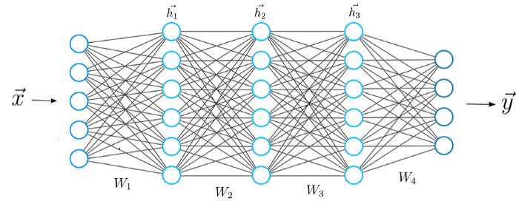
Introduction
Detecting human emotions like angry, fear, happy with the help of machine learning (Deep Learning) and generating respective emoji.
We will use deep learning to detect human emotions from images. We will classify human facial expressions to filter and map corresponding emojis or avatars with the help of neural networks. To achieve this we would be using tensorflow and keras libraries.
To achieve this, deep learning uses a multi-layered structure of algorithms called neural networks.

Slide 3
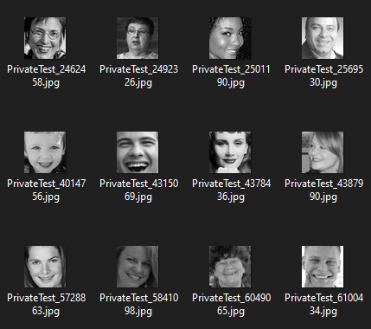
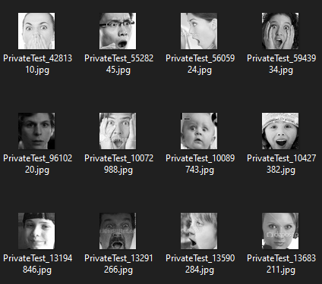
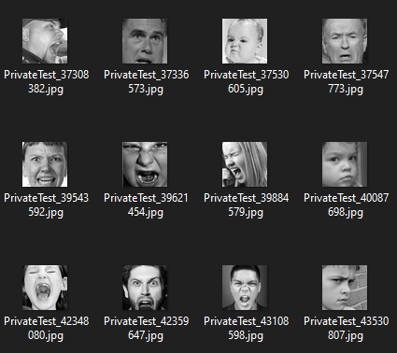
Data Set
For this project we are going to use data set from Kaggle. FER-2013 | Kaggle
The data consists of 48x48 pixel grayscale images of faces.
The training set consists of 28,709 examples and the public test set consists of 3,589 examples.
Happy images
Surprised images
Angry images

Slide 4






Technologies Used
Python
VS Code
NumPy
TensorFlow
Keras
OpenCV

Slide 5
Steps to create project
Creating a python script named as train.py.
Importing relevant libraries such as numpy, keras.
Initialize the training and validation generators.
Build the convolution network architecture.
Compile and train the model.
Save the model weights.

Slide 6
Steps to create project
Creating a python script named as gui.py.
Using openCV haarcascade xml detect the bounding boxes of face in the webcam and predict the emotions.
Creating a folder named emojis.
Saving the emojis corresponding to each of the seven emotions in the dataset.
Using camera to detect the emotions in real time and generating relevant emojis with it.

Slide 7

Creating Jupiter notebook
Creating “train.ipynb” for training our machine learning model.

Slide 8
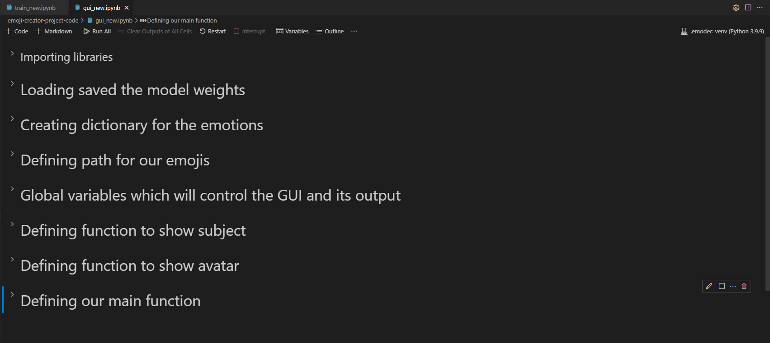
Creating Jupiter notebook
Creating “gui.ipynb” for creating user interface of our machine learning model.

Slide 9
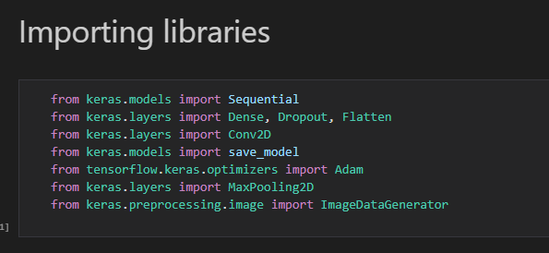
Libraries for Training

Slide 10
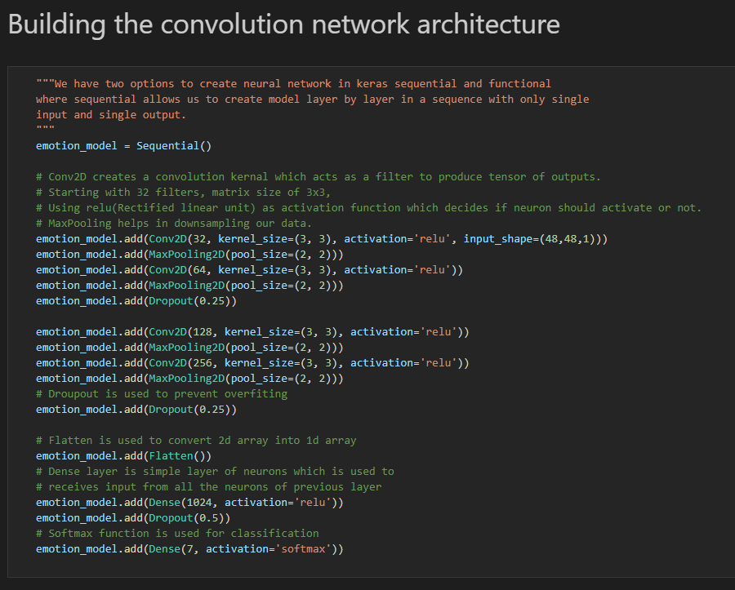
Building our Neural Network

Slide 11
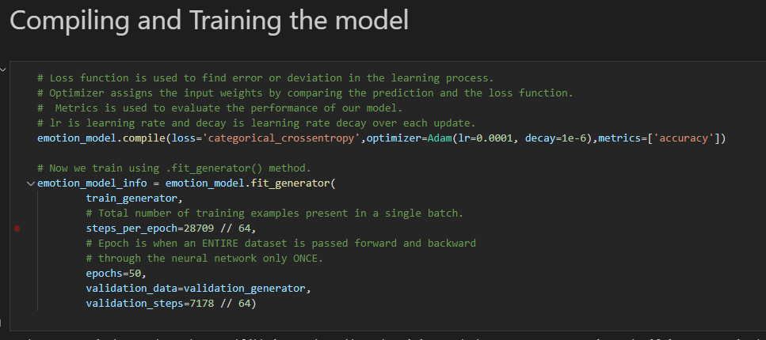
Compiling and Training the Model

Slide 12
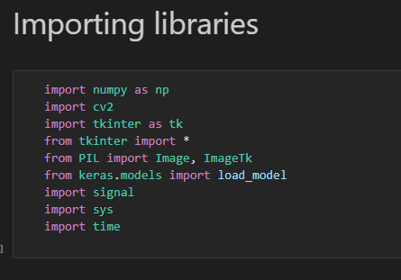
Libraries for GUI

Slide 13
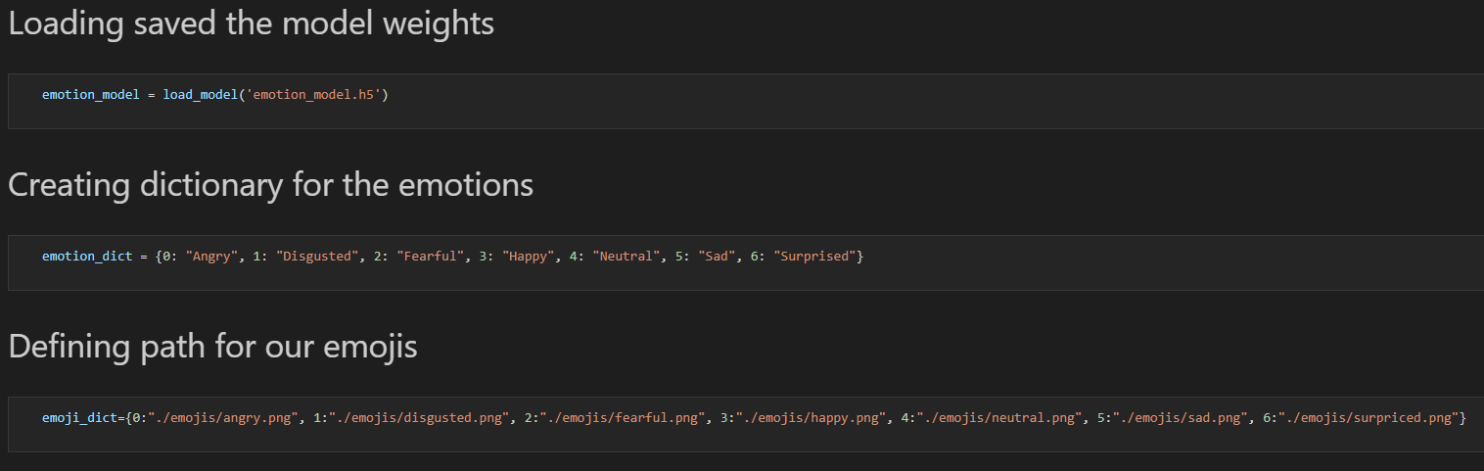
Creating Emotion Dictionary and Loading Model

Slide 14
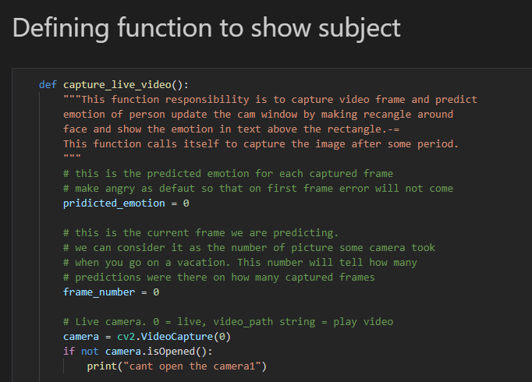
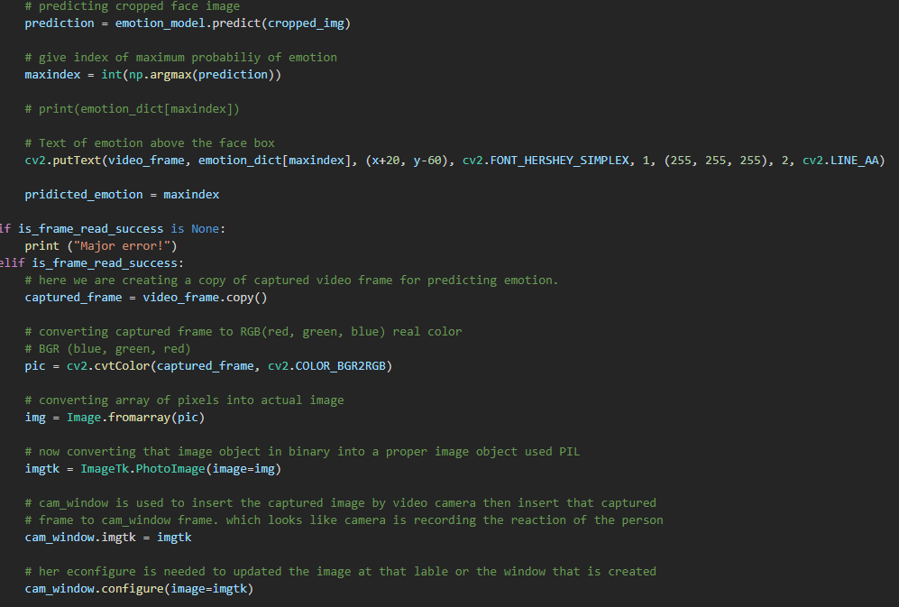
Function to Show Subject

Slide 15
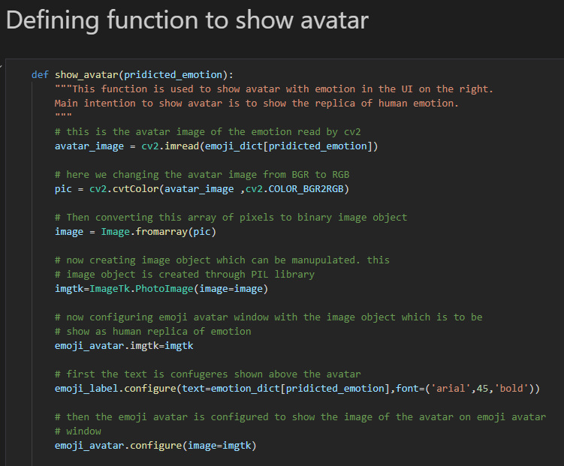
Function to Show Emoji

Slide 16
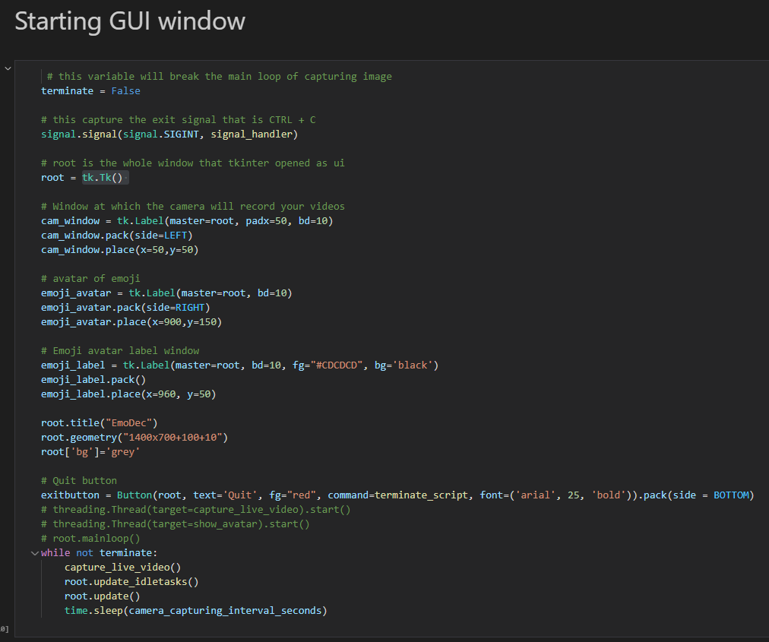
Starting GUI Window

Slide 17
GIF of Final Result

Slide 18
Conclusion
In this project, we tried to classify facial emotions over static facial images using deep learning techniques. The face detection and emotion recognition are very challenging problems. They require a heavy effort for enhancing the performance measure of face detection and emotion recognition. This area of emotion recognition is gaining attention owing to its applications in various domains such as gaming, software engineering, and education.
Our project had one major limitation: the lack of an extensive dataset of emotions. For instance, we used a dataset containing 28,709 images. By having a larger dataset, we could improve our results.
Thus, with the help of Google’s Tensorflow and implementation of deep neural network we were able to classify human emotions with image data.

Slide 19
References
www.Google.com
www.YouTube.com
www.geeksforgeeks.org
www.tutorialspoint.com
https://docs.python.org
https://keras.io
https://towardsdatascience.com
www.stackoverflow.com
https://docs.opencv.org
https://www.pyimagesearch.com

Slide 20
Thank You

